Slide 1
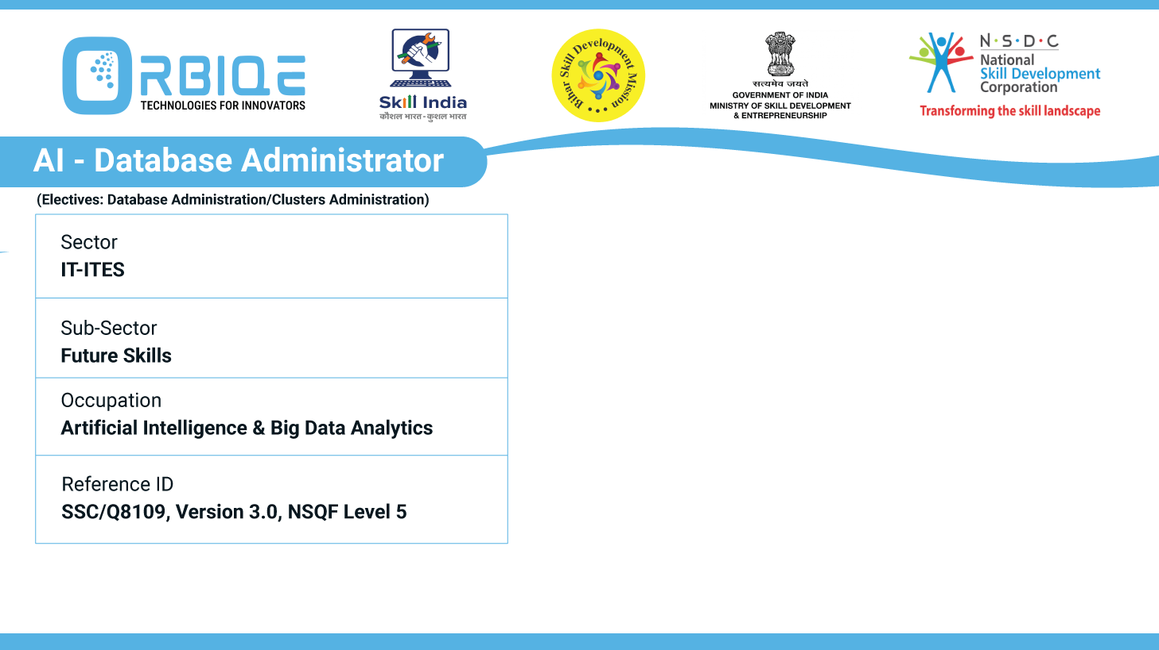
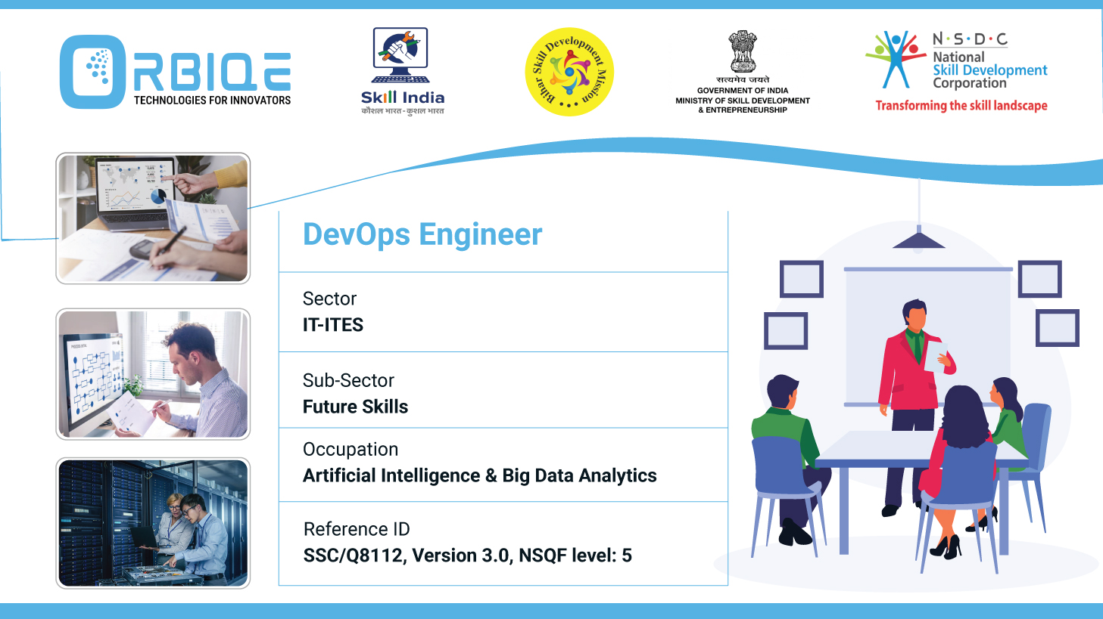
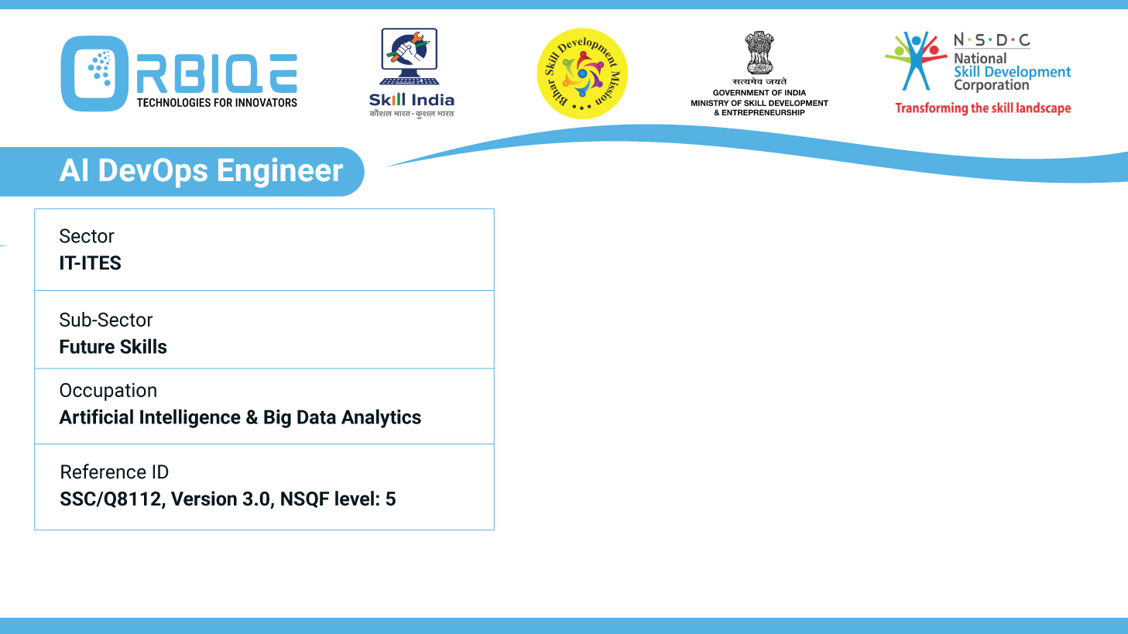
Name- Krishna Kant Dubey

Slide 2

Documenting the Data: Creating Comprehensive Database Documentation

Slide 3
Agenda
Create sample documentations related to new databases, emphasizing the importance of comprehensive documentation for effective database management and collaboration

Slide 4
Structured set of sample documentation templates for new databases
Database Overview
Schema Documentation
Data Flow & ETL Processes
Security & Access Controls
Backup & Recovery
Change Log

Slide 5
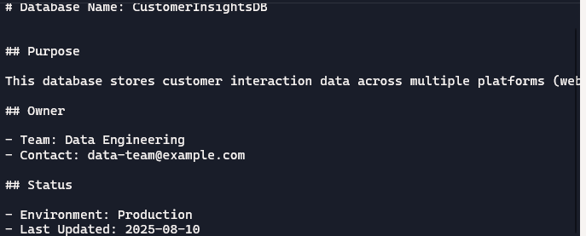
Database Overview

Slide 6
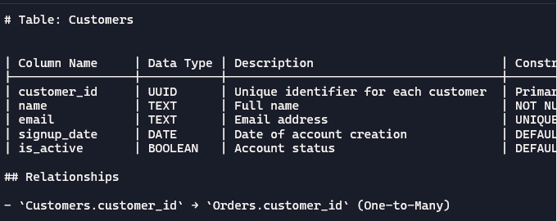
Schema Documentation

Slide 7
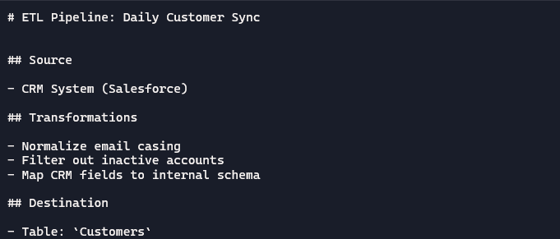
Data Flow & ETL Processes

Slide 8
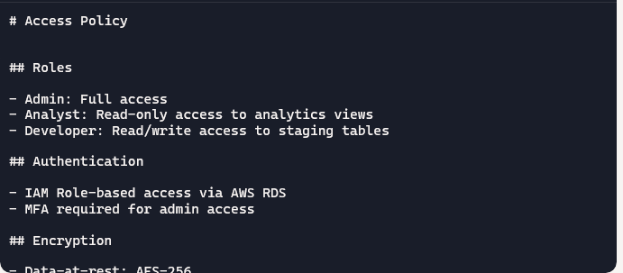
Security & Access Controls

Slide 9
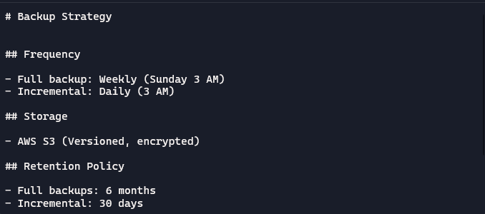
Backup & Recovery

Slide 10
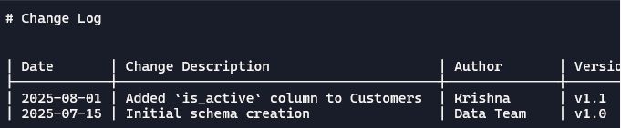
Change Log

Slide 11
Thank You

